Slide 1

Surgical Video Analysis
AIML Project Elective Term II 2022-23
Week II Mar 10 – Mar 17

Slide 2
Task Assigned
Task: Surgical Tool Localization
Dataset: m2cai-16 tool locations

Slide 3
This week..
Dataset
You Only Look Once Architectures
YOLO v1
YOLO v2
YOLO v7

Slide 4

Dataset

Slide 5
Introduction
Mortality rate of major procedures: 0.5-5%
Lack in surgical supervision – tackled by real-time supervision
Rich analysis requires spatial bounds to the tools and observing their movement efficiently.
New dataset: m2cai-16-tool locations
Leverage R-CNNs – outperform existing

Slide 6
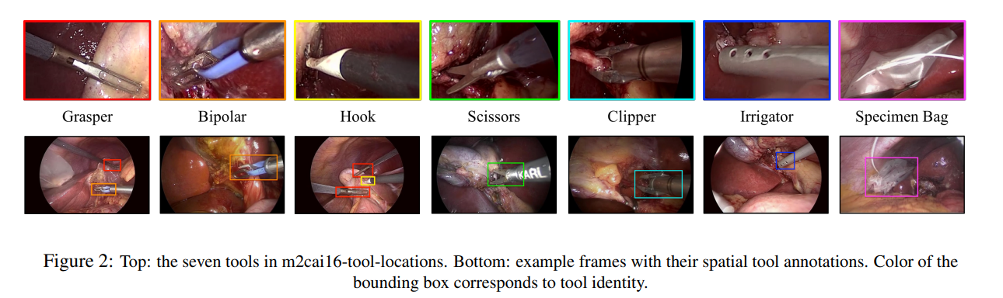
Tools

Slide 7
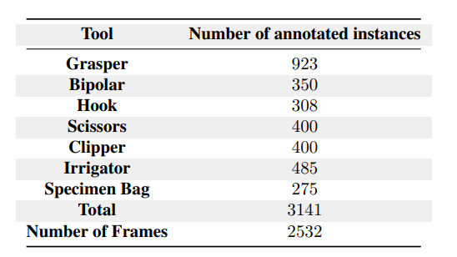
Dataset
m2cai-16 tool and Cholec80: surgical video frames along with binary annotation of tool presence
m2cai-16 tool locations – extension of m2cai-16 tool dataset with spatial locations
Label 2532 frames(selected from 23K frames of m2cai-16 tool dataset) with 50-30-20 split.
We first annotate all frames containing just one tool, and increase the number of annotated instances per tool class by additionally labeling frames with two and three tools

Slide 8
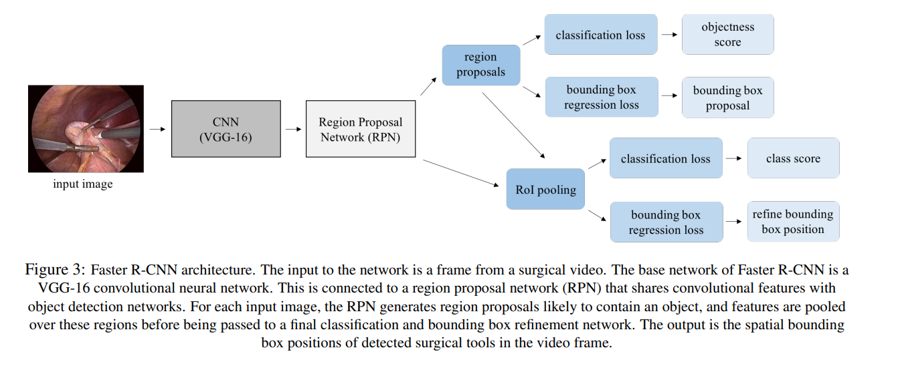
Architecture

Slide 9

YOLO v1

Slide 10
Introduction
Object detection as a Regression Task with a single neural network
You Only Look Once at an image to predict what objects are present along with their location
Very Fast, Generalized.
YOLO: 45fps
Fast YOLO: 155fps
Twice the mAP and half the back-ground errors than Fast R-CNN

Slide 11
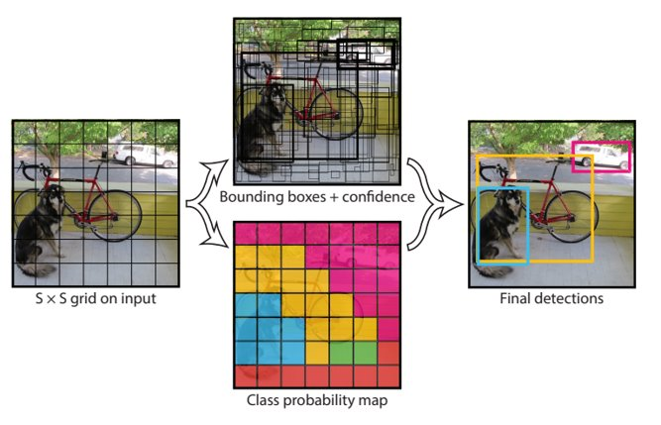
Unified Detection
Separate components for object detection is now a single network

Slide 12
Steps
If a grid cell contains center of an object, it is responsible for the object's detection
Each grid cell predicts:
B bounding boxes: x,y,w,h
Confidence score for each box: Pr(Obj)×IOU(truth,pred)
Conditional class probabilities for each class: Pr(C_i/Obj)
These scores encode both the probability of that class appearing in the box and how well the predicted box fits the object.
Input image => S×S image
Confidence score for each box * Conditional class probabilities = Probability that a class is present in the box (Pr(C_i)×IOU)
For each grid: 5 values for each bounding box and C class probabilities: 5 B+C
So, the output is of S×S×(5B+C)

Slide 13
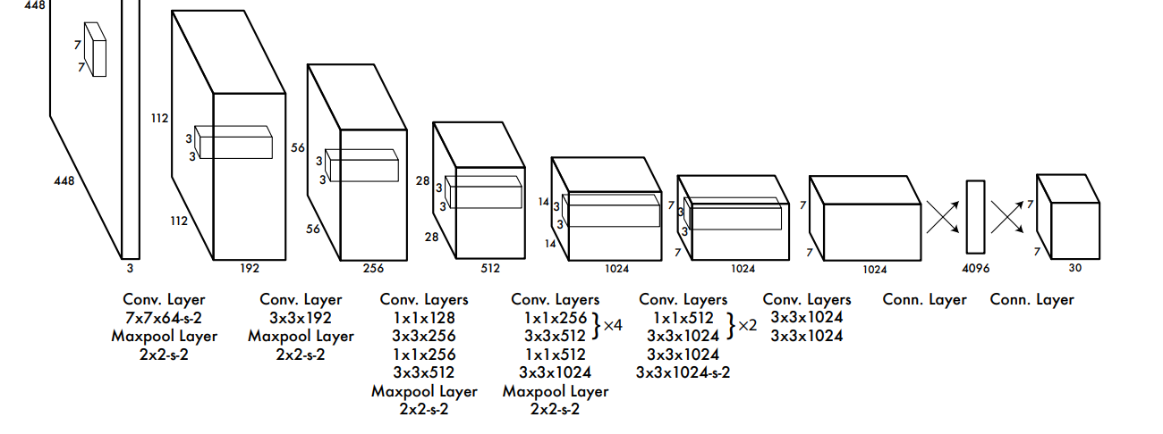
Architecture
24 convolution layers and 2 fully connected layers
1x1 reduction layers followed by 3x3 convolution layers

Slide 14
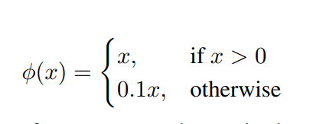
Training the network
First 20 conv layers + avg pooling layer + FC layer on 1000 class ImageNet
Adding layers to trained model => improvement in accuracy
Activation function:
Final layer: linear
Remaining layers: leaky linear
Error function : sum-squared error – easy to optimize but..
Weights localization error = classification error
Weights large box errors = small box errors

Slide 15
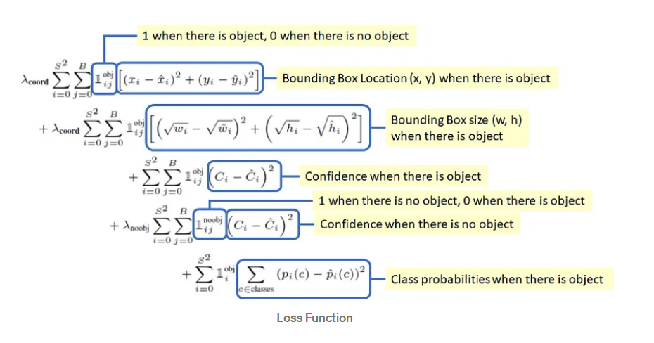
Loss Function

Slide 16
YOLO v2

Slide 17
Improvements from v1
Batch Normalization after every conv layer
Increase in resolution while training and so the epochs
Replacing fc layers with anchor boxes.
To employ good anchors for training, use K-means with K=5 and IOU as distance metric
Constrained dimensions*
Multi-scale training for a robust network
Reference: Object Detection Explained: YOLO v2. | by Ching (Chingis) | MLearning.ai | Medium

Slide 18
YOLO v7

Slide 19
Introduction
SOTA result – 56.8% mAP; 30fps processing speed on GPU v100
Trained solely on MS COCO dataset

Slide 20
Aim
Uses Trainable bag-of-freebies
Improve detection accuracy without increasing the inference cost
Issues in evolution of obj detection methods:
how re-parameterized module replaces original module
Dynamic label strategy
extend and compound scaling methods – effective usage of params
Reduce the parameters by 50%

Slide 21
SOTA characteristics
Faster and stronger architecture
Effective feature integration
Robust loss function
Efficient label assignment
Accurate Detection
Efficient training

Slide 22
Model re-parameterization
Merge multiple computational modules into one at inference stage
Used for:
Optimization
Regularization – prevent overfitting
Interpretable and understandable model
Compatible to various architectures
Overall, it improves performance and robustness of a model

Slide 23
Model re-parameterization
Model-level:
Average weights of identical models trained on various data
Weighted avg of the weights of models at different iteration number
Module-level:
Split into different module branches during training and re-integrate them while inference

Slide 24
Model Scaling
Scale a pre-designed architecture
Makes architecture fit into different computing devices
Factors that can be scaled:
Resolution of I/P
Depth of n/w
no.of channels
Stage
NAS: a method

Slide 25
Next Week..
YOLO v7 architecture
Bag-of-freebies
Visual Recognition course project – related to my work on object localization

Slide 26
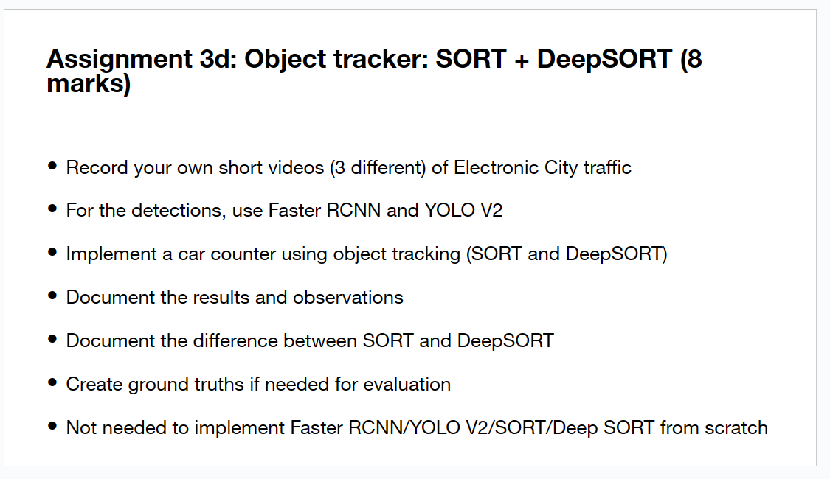

Slide 27

THANK YOU
N V Sai Likhith
IMT2020118

